Slide 1
Interaction Diagram Notation
From Chapter 15 of
Craig Larman, Applying UML and Patterns
John Dalesandro

Slide 2
Objectives
Read basic UML Interaction (Communication and Sequence) Diagram notation

Slide 3
Decomposition Tools
Different styles of software development are often characterized by a strong reliance on a particular modeling tool during the design phase.
Relational Database designers tend to depend heavily on Entity Relationship Diagrams.
Functional/Procedural designers may use a tool like Function Decomposition Diagrams.
eXtreme Programming designers often use Class Responsibility Collaboration Cards.

Slide 4
Object-Oriented Decomposition
The modeling genre of choice for most object-oriented designers is the Unified Modeling Language.
The most important activity in object-oriented design is assigning responsibility to objects.
The preferred tool to assist object-oriented designers in assigning responsibility to objects are the two UML interaction diagrams.

Slide 5
Introduction
Why do objects exist?
  To perform an activity to help fulfill a system’s purpose
Interaction Diagrams are used to model system dynamics
  How do objects change state?
  How do objects interact (message passing)?

Slide 6
Communication & Sequence Diagrams
An Interaction Diagram is a generalization of two specialized UML diagram types
  Communication Diagrams: Illustrate object interactions organized around the objects and their links to each other
  Sequence Diagrams: Illustrate object interactions arranged in time sequence

Slide 7
Communication & Sequence Diagrams (2)
Both diagram types are semantically equivalent, however, they may not show the same information
  Communication Diagrams emphasize the structural organization of objects, while Sequence Diagrams emphasize the time ordering of messages
  Communication Diagrams explicitly show object linkages, while links are implied in Sequence Diagrams

Slide 8
Interaction Diagrams Are Valuable
Interaction Diagrams provide a thoughtful, cohesive, common starting point for inspiration during programming
Patterns, principles, and idioms can be applied to improve the quality of the Interaction Diagrams

Slide 9
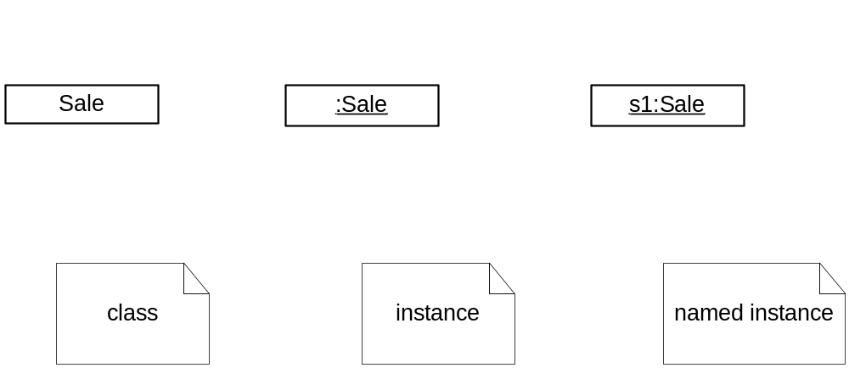
Common Interaction Diagram Notation

Slide 10
Communication Diagrams
Objects are connected with numbered (sequenced) arrows along links to depict information flow
Arrows are drawn from the interaction source
The object pointed to by the arrow is referred to as the target
Arrows are numbered to depict their usage order within the scenario
Arrows are labeled with the passed message

Slide 11
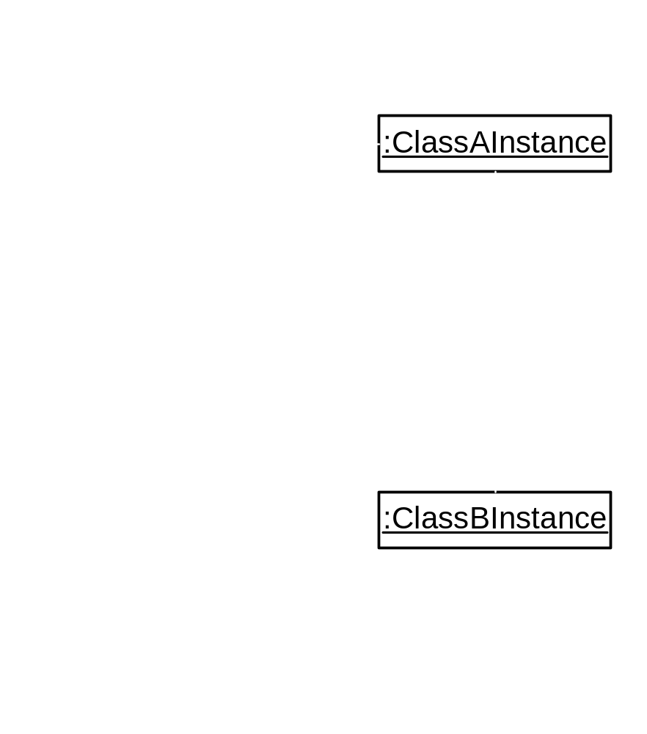
Example Communication Diagram

Slide 12
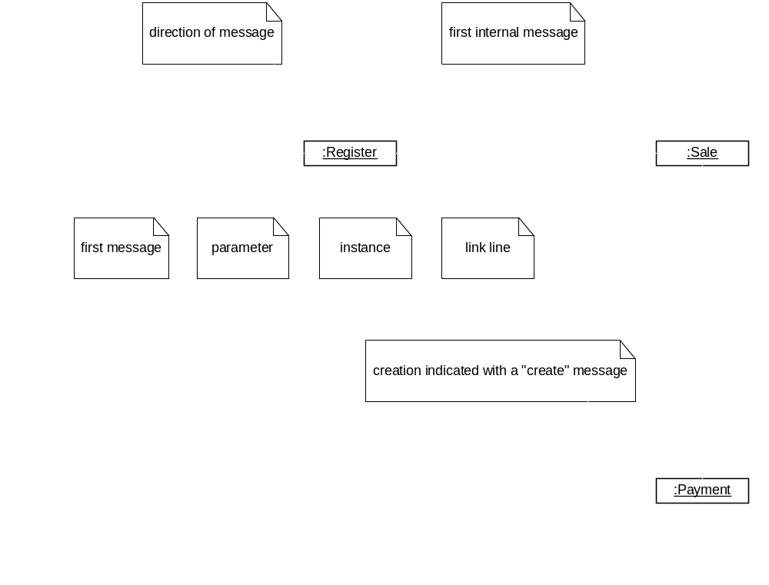
Example Communication Diagram: makePayment

Slide 13
Basic Communication Diagram Notation
Link - connection path between two objects (an instance of an association)
Message - represented with a message expression on an arrowed line between objects
Sequence Number - represents the order in which the flows are used

Slide 14
Basic Communication Diagram Notation (2)
Conditional Message
  Seq. Number [ variable = value ] : message()
  Message is sent only if clause evaluates to true
Iteration (Looping)
  Seq. Number * [ i := 1..N ]: message()
  “*” is required; [ ... ] clause is optional

Slide 15
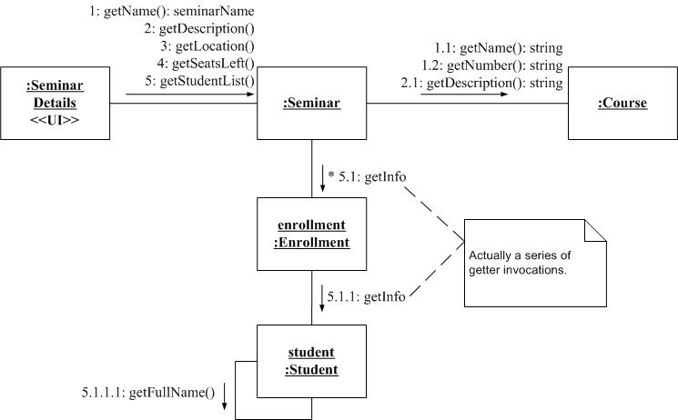
Communication Diagram from AgileModeling.com

Slide 16
Sequence Diagrams
Correspond to one scenario within a Use Case
Model a single operation within a System over time
Identify the objects involved with each scenario
Identify the passed messages and actions that occur during a scenario
Identify the required response of each action

Slide 17
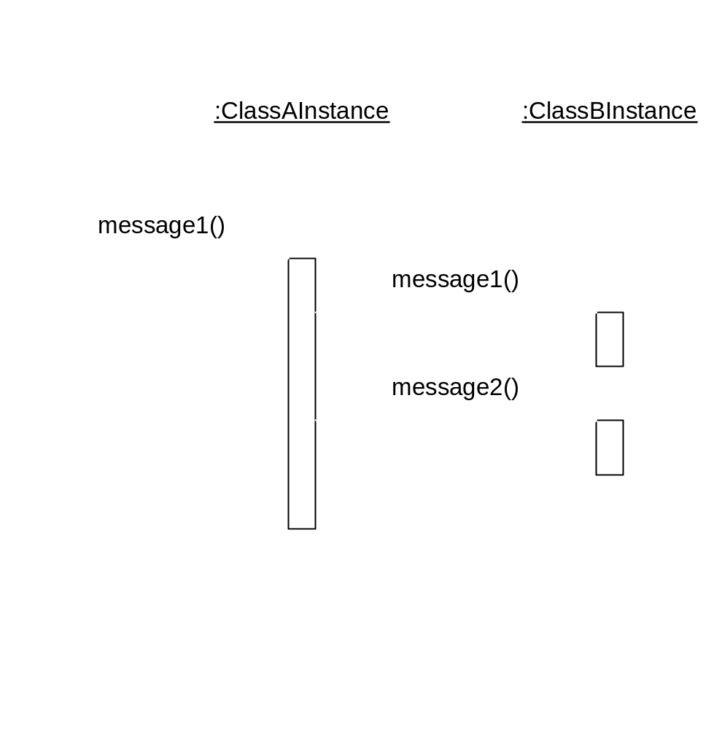
Example Sequence Diagram

Slide 18
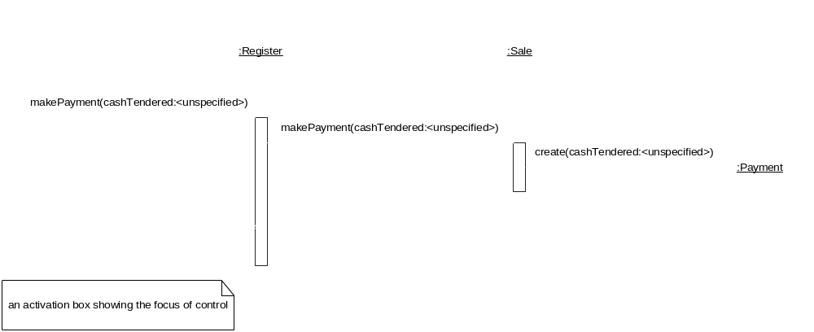
Example Sequence
Diagram: make Payment

Slide 19
Basic Sequence Diagram Notation
Links - Sequence Diagrams do not show links
Message - represented with a message expression on an arrowed line between objects

Slide 20
Basic Sequence Diagram Notation (2)
Object Lifeline - the vertical dashed line underneath an object
  Objects do not have a lifeline until they are created
  The end of an object’s life is marked with an “X” at the end of the lifeline
  Passage of time is from top to bottom of diagram

Slide 21
Basic Sequence Diagram Notation (3)
Activation - the period of time an object is handling a message (box along lifeline)
  Activation boxes can be overlaid to depict an object invoking another method on itself

Slide 22
Basic Sequence Diagram Notation (4)
Conditional Message
  [ variable = value ] message()
  Message is sent only if clause evaluates to true
Iteration (Looping)
  * [ i := 1..N ]: message()
  “*” is required; [ ... ] clause is optional

Slide 23
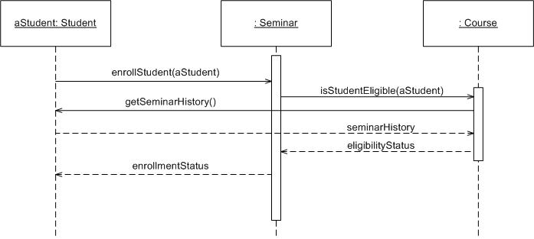
Sequence Diagram from AgileModeling.com

Slide 24
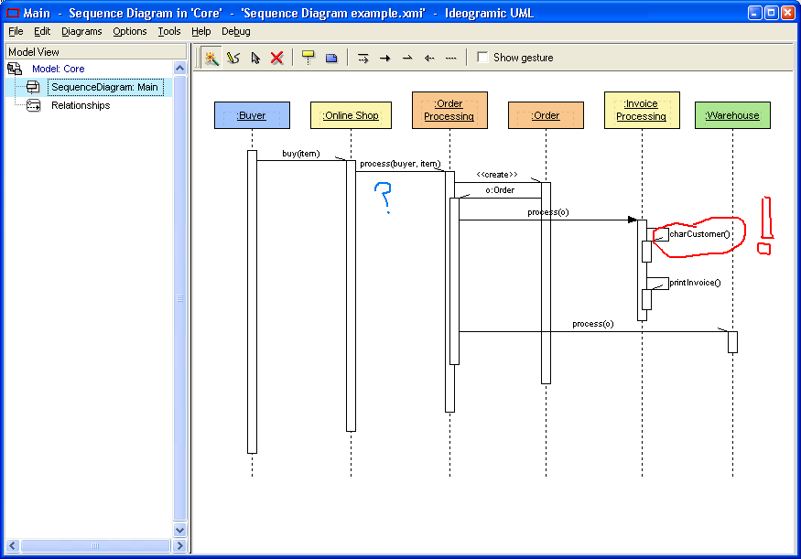
Sequence Diagramming with Ideogramic Modeling Tool

Slide 25
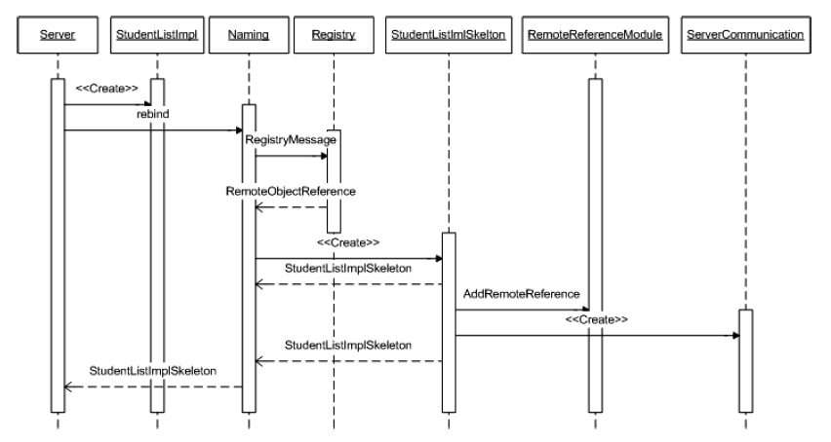
Sequence Diagram for Java Remote Method Invocation http://nathanbalon.net/projects/cis578/cis578_middleware_report.pdf

Slide 26
Interaction Diagram Strengths
Communication Diagram
  Space Economical - flexibility to add new objects in two dimensions
  Better to illustrate complex branching, iteration, and concurrent behavior
Sequence Diagram
  Clearly shows sequence or time ordering of messages
  Simple notation

Slide 27
Interaction Diagram Weaknesses
Communication Diagram
  Difficult to see sequence of messages
  More complex notation
Sequence Diagram
  Forced to extend to the right when adding new objects; consumes horizontal space

Slide 28
Conclusions
Beginners in UML often emphasize Class Diagrams. Interaction Diagrams usually deserve more attention.
There is no rule about which diagram to use. Both are often used to emphasize the flexibility in choice and to reinforce the logic of the operation. Some tools can convert one to the other automatically.

